Slide 1


Lewisham Biodiversity Partnership meeting
14 July 2021

Slide 2
Agenda
Welcome/Introductions/Apologies
Big City Butterflies project – Butterfly Conservation
Minutes and matters arising
Kenneth White Legacy Award applications
Biodiversity Partnership Summary Report and Highlights
Lewisham update
Partner updates (not covered above)
AOB
Next meeting

Slide 3
Minutes and matters arising
PM to connect RG to London Allotment Officers Association – done
All to remember to send stats and sightings to JK/EWD so we can have an accurate record on what is happening in the Borough – ongoing
Projects that received funding from 2020 KW award: To send photos of projects – ongoing
All who is interested in attending the first aid training: To let JK/EWD know so we can see numbers and organise the training. – ongoing

Slide 4
Kenneth White Legacy Award
13 applications, 14 votes for shortlisting – thank you!
Organisation | Project | Amount | Votes
Christ the King Sixth Forms | Hedgehog house and wildlife camera to monitor biodiversity and involve students in the school | £270.00 | 10
Friends of Brookmill Park | Planting native hawthorn hedgerow in Brookmill park | £270.00 | 9
Friends of Home Park | Install sparrow nesting boxes on to buildings and on trees in Home Park | £325.00 | 7
Buckthorne Road (Fourth Reserve) | Install wildlife cameras to monitor the wildlife using the habitats created in the reserve | £415.00 | 6
Albion Millennium Green | Install bird and bat boxes and conduct biodiversity survey involving local schools and the local community | £220.00 | 5
Dacres Wood Group | Planting native plants with local schools as part of the improvement of the Silverdale Enclosure | £270.00 | 5
Oldstead Road Allotments | Creation of a wildlife pond (part funded) | £300.00 | 5
Grove Park Community Group | Sourcing tools to manage the woodland area in the Ringway Centre by local volunteers | £401.48 | 5
Chinbrook Community Orchard | Replant some of the original tree varieties, plant wildlife friendly plants and install bird boxes | £169.85 | 4
 | Total amount | £2,641.33

Slide 5
Kenneth White Legacy Award
Remaining applications
Organisation | Project | Amount | Votes
Sydenham Wells Park Improvement Group | Bat and bird boxes in Sydenham Wells Park | £388.00 | 3
Friends of Garthorne Road NR | Printing 300 leaflets about the reserve’s biodiversity to engage families at open days | £300.00 | 3
Taylors Lane Allotments | Clearing an area to create wildlife friendly habitat with wildflowers and creeping plants and improve the pond | £240.00 | 3
Hazelbank Allotments | Installing bee hotels, frog homes and seeding pollinator friendly plants on plots | £586.94 | 2
 | Total amount | £1,514.94

Slide 6
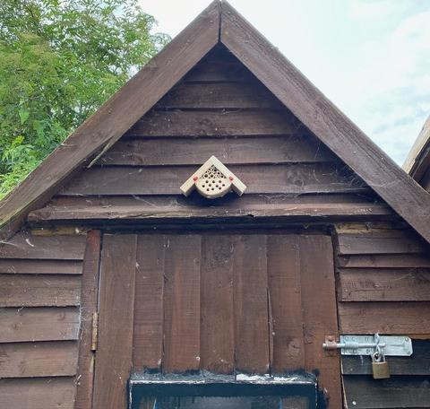
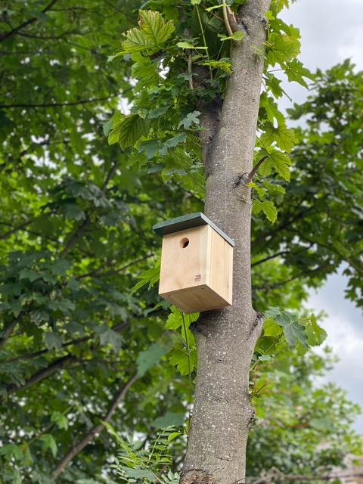
Biodiversity Partnership Summary Report and Highlights
Total Outputs April – June 2021
 | Events | Adults | Children | Awards
 | 222 | 1711 | 2065 | 0
Environmental education
117 events, 425 adults and 1870 children
Volunteer events
89 events, 667 adults and 29 children
Engagement (walks etc.)
16 events, 619 adults and 166 children
Habitat/Species outputs | Category
 | Hedge (m) | Loggery | Bird box | Bat box | Bug hotel | Other habitat | Trees
 | 7 | 2 | 27 | 13 | 1 | See below | 5
Other habitats created this quarter include;
50m2 meadow creation
8 reptile refugia
8 insect hotels
1 hedgehog house
3 roosting pockets
Tree nester
2 wildlife ponds

Slide 7
Surveys
Surveys |  | Category
Location | Number | Type of survey
Sydenham Garden | 2 | Living roof plant survey
Beckenham Place Park | 2 | Bird
Hilly Fields | 3 | Bird
Ladywell Fields | 3 | Bird
River Pool Linear | 1 | Bird
Garthorne road | 3 | Butterfly
Manor Park | 3 | Riverfly
Brookmill Park | 3 | Riverfly
Brookmill Park | 3 | Bird
Ladywell Fields | 3 | Riverfly
Linear Park | 3 | Riverfly
Beckenham Place Park | 3 | Riverfly
Devonshire Road | 3 | Butterfly
Devonshire Road | 3 | Bird
Total | 38

Slide 8
Birds & Other sightings of interest
Peregrine falcon spotted in St. Pauls Churchyard, Deptford.
Tawny owl in Grove Park LNR.
Red kite spotted over Beckenham Place Park
Slow worms and stag beetles at Buckthorne Road
Lots of sightings of Peacock butterflies.
Hedgehog spotted near Grove Park LNR
Biodiversity Partnership Summary Report and Highlights

Slide 9
Lewisham update
Jess
  Nature’s Gym
  3 Rivers Clean Up
  Forest Schools
  First Aid Training
2021 Rivers and People Stats
Date | Location | People | Rubbish bags | Himalyan Balsam (Plants) | Face masks
15/05/2021 | Brookmill Park | 6 | 8 | 50 | 8
20/05/2021 | Brookmill Park | 5 | 8 | 170 | 2
29/05/2021 | Lewisham Gateway | 9 | 20 | 90 | 0
30/05/2021 | Beckenham PP | 11 | 10 | 190 | 2 | 1 trolley
01/06/2021 | Cornmill Gardens | 6 | 4 | 5 |  | 1 trolley, 1 duvet
02/06/21 | River Pool upstream | 8 | 6 | 0
03/06/21 | Quaggy (Gilmore Road to Lewisham) | 2 | 4 | 40
05/06/21 | Cornmill Gardens | 5 | 4 | 10
8/6/2021 | Lidl, Lee HR | 10 | 25 | 16 | 0 | 3 Giant Hogweed
08/06/2021 | Ladywell Malyons Rd | 6 | 6 | 60 | 0 | 1 signal crayfish, 1 trolley
09/06/2021 | Brookmill Park | 12 | 15 | 65 | 2 | 2 Giant Hogweed
10/06/21 | Manor Park | 5 | 5 | 150 |  | 1 traffic cone
15/06/2021 | Mottingham Lane | 10 | 9 | 20 | 2 | 2 Giant Hogweed
15/6/21 | Manor Park | 6 | 4 | 150 | 0
19/06/2021 | Ladywell F (South) | 16 | 25 | 0 | 4 | 2 trolleys
23/06/21 | Linear Park, River Pool | 11 | 6 | 67 |  | 1 Giant Hogweed
22/06/21 | Cornmill Gardens | 8 | 10 | 1 |  | 1 mattress, 1 gheto blaster
 | TOTALS | 167 | 191 | 4904 | 23

Slide 10
Judith
  Rivers and People volunteering
  Nature’s Gym
  3 Rivers Clean Up

Slide 11

Lewisham update
Lucy
  BPP flower, art and dog show will be on 1 August 12-7pm. Pleased register and spread the word!
  2 Buzzards over BPP

Slide 12

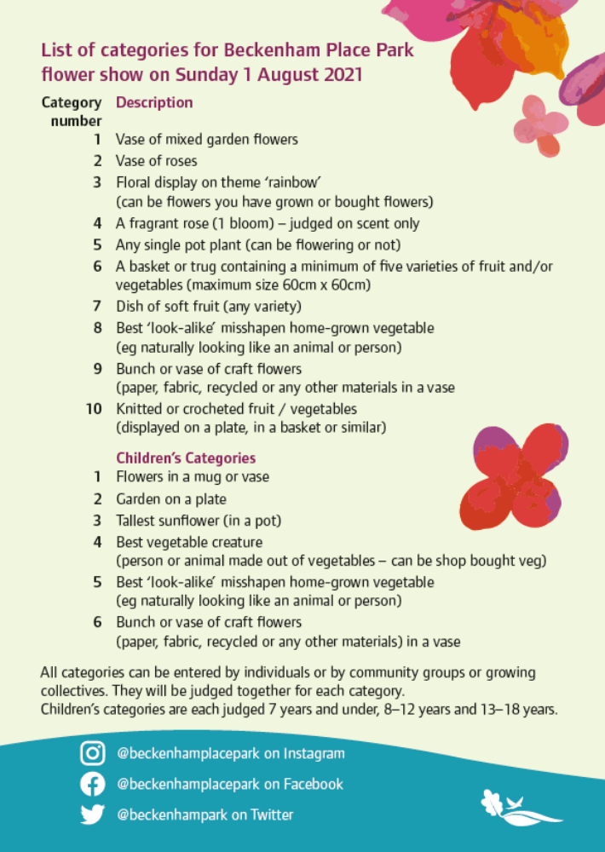
Lewisham update

Slide 13
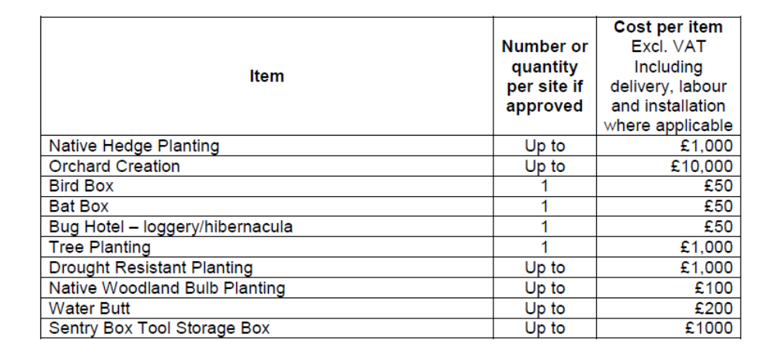
Lewisham update
Eszter/Peter
  NCIL (25th July), Grow Back Greener (13th September)
  New Greening Fund, key themes: Access, Young People and Play, and Biodiversity and Sustainability (24th September)
  Covid Community Champions
  Call to share your skills/expertise
  Lewisham BAP – thank you for comments!
    Woodlands will be added
    Still work in progress

Slide 14
Agenda
Welcome/Introductions/Apologies
Big City Butterflies project – Butterfly Conservation
Minutes and matters arising
Kenneth White Legacy Award applications
Biodiversity Partnership Summary Report and Highlights
Lewisham update
Partner updates (not covered above)
AOB
Next meeting – 4pm 13th October

Slide 15
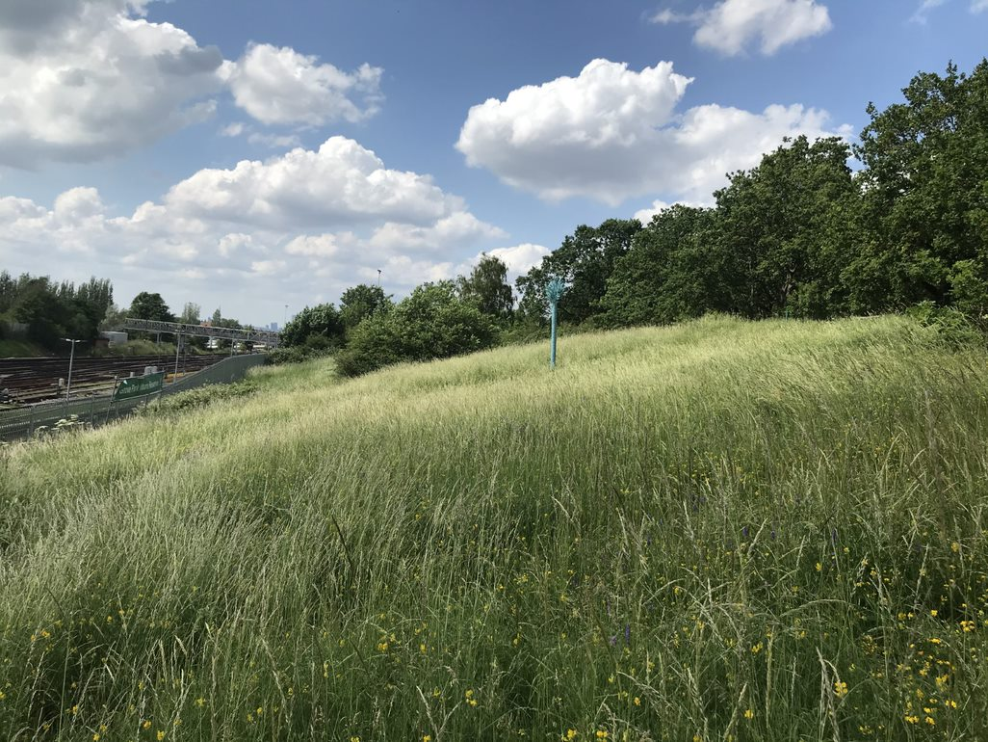

New section slide
Thank you!

