Slide 1
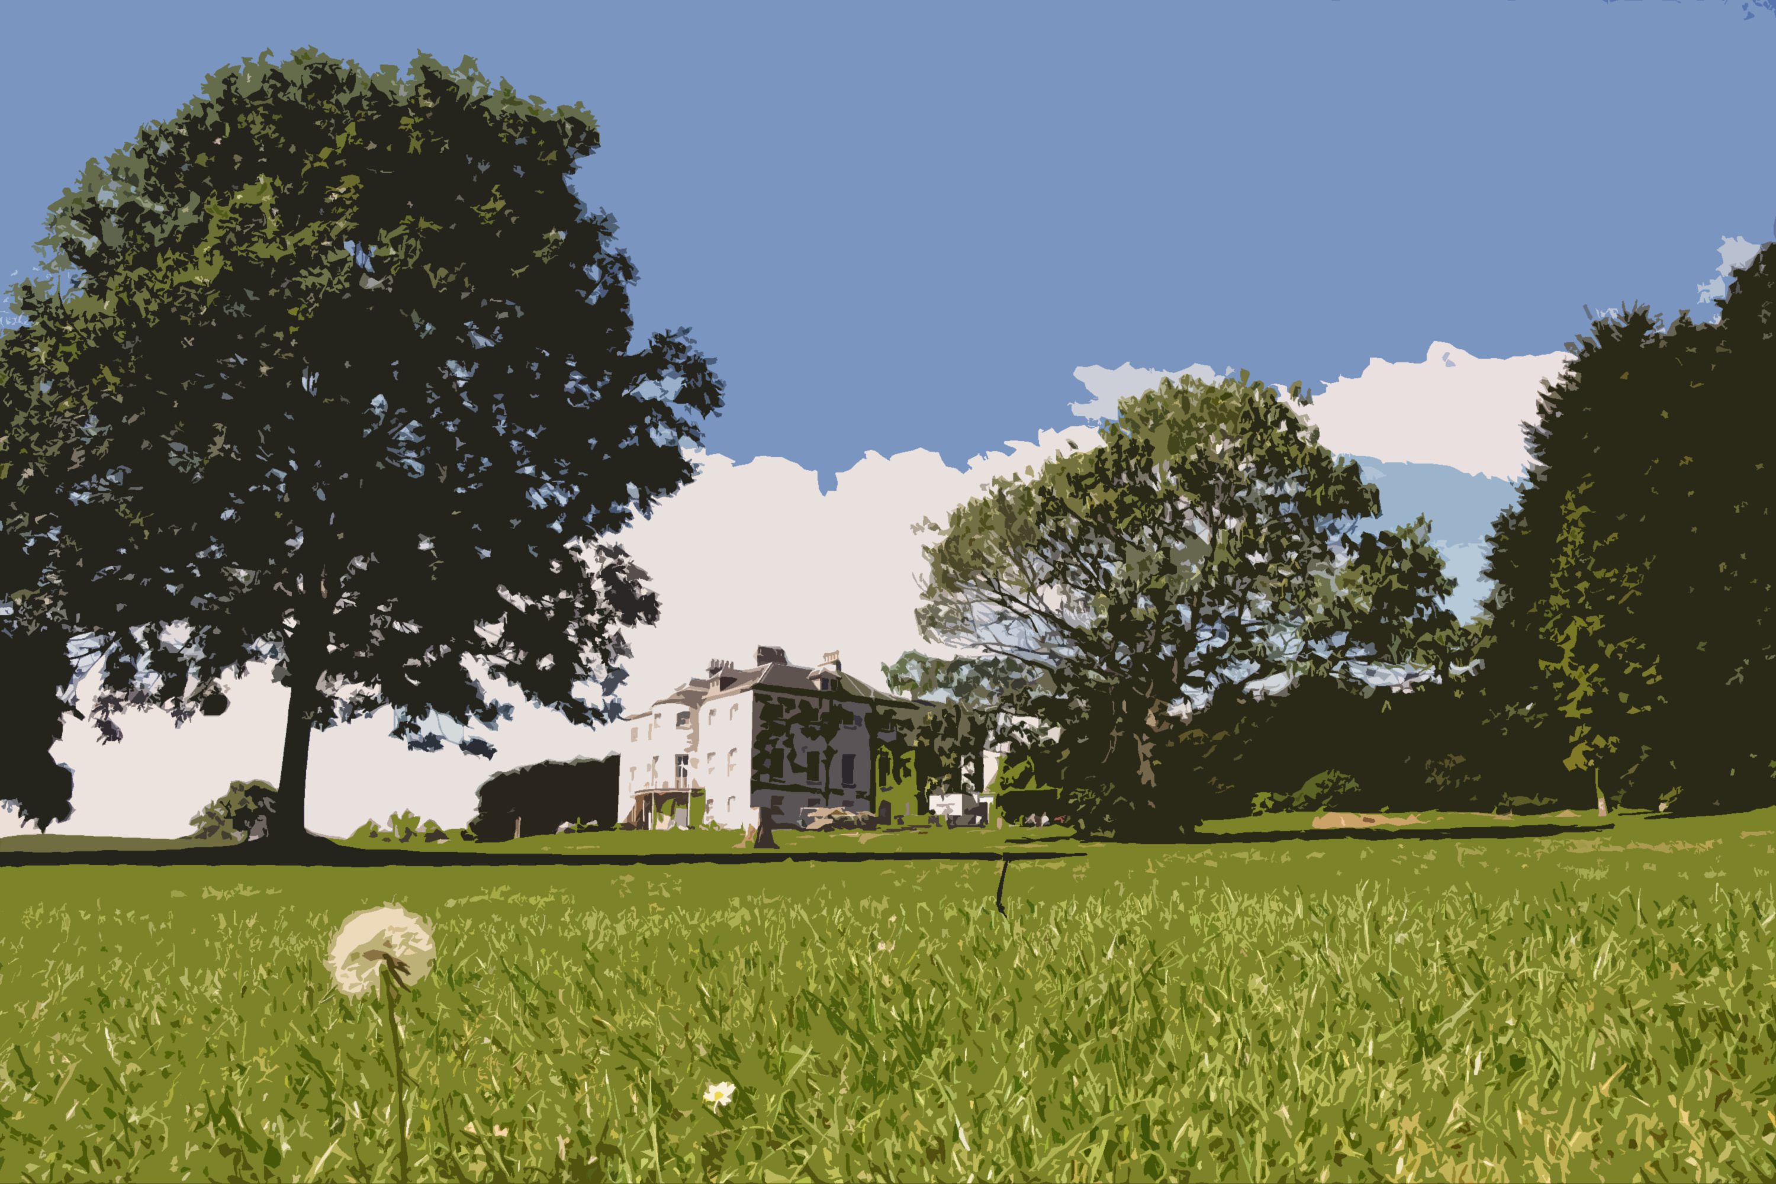

Be a park
Hero
Help keep Beckenham Place Park litter and dog mess free!

Slide 2
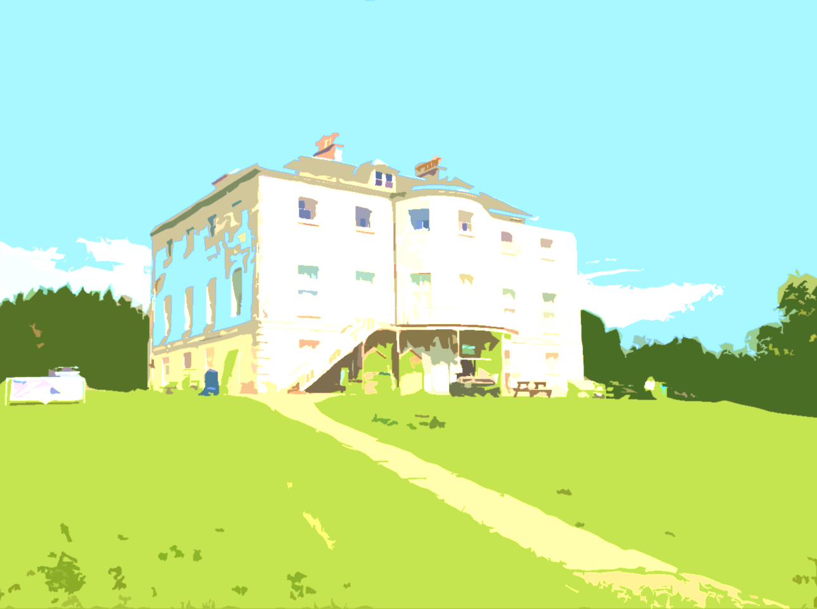
What you need to do to be a hero!
Design an A4 colour poster that encourages park visitors to use the bins provided for litter OR dog mess.
The design should be eye catching and clear so that people can see it and read any words from a distance.
It should get across the message that leaving litter or dog mess in the park isn’t nice for other park users and is not good for the environment.
If the design relates to dog mess, please include that it must be bagged before binning

Slide 3

What you need to say to be a hero!
There is no need to include the name ‘Beckenham Place Park’ on your design if you don’t want to (it is a long name and might be hard to fit on!) You can just shorten it to ‘park’ or ‘the park’ if you want to refer to the park.
The bins that the stickers will be put on are not recycling bins. If people want to recycle their rubbish they will need to take it home with them. We want to encourage them to do this, so you could mention it in your design if you wish.

Slide 4

What you need to say to be a hero!
The bins are often very full, especially in the summer, and it is hard for the park staff to empty them quickly enough. If they overflow, the rubbish blows around the park looking messy and could harm the wildlife.
We would like people who create lots of rubbish (e.g. from a picnic) to take their rubbish home with them.
Beckenham Place Park is in Lewisham (and is managed by Lewisham Council).

Slide 5

What you need to say to be a hero!
It is up to you whether you wish to include your name in the poster design.
Create your poster at A4 size and fill the whole page so it makes it easier to be printed.

Slide 6
The Prize!
There will be three winners. The three winning posters will be made into A4 size stickers and stuck on the litter bins in the park.

Slide 7
How to send your poster in!
How to enter: Ask a responsible adult to email your image as a pdf to beckenhamplacepark@lewisham.gov.uk
We cannot accept emails directly from children.
If scanning or photographing your poster, please make sure that it is a clear image.
In the email please include: Your name, age, post code, school name and your school year
You can also post your entry to: Lucy Mitchell, Gardener’s Cottage, Beckenham Place Park, Beckenham Hill Road, London BR3 1SY.
If posting, please write your name, age, postcode, school name, your school year, and contact email or phone number for a responsible adult on the back of your poster.

Slide 8
The deadline!
All entries must be in by 5pm Wednesday 31 March 2021

Slide 9
The rules
The competition is open to anyone aged 13 or under. The poster can be designed by hand or on a computer. You may submit more than one entry, but there can only be one winning entry per person. The competition will be judged by members of Beckenham Place Park staff team and the judges’ decision is final. We cannot accept responsibility for any entries that are lost in the post and don’t reach us.
For any further information regarding this competition, please email beckenhamplacepark@lewisham.gov.uk

