Slide 1
Brockley and Ladywell Cemeteries
2016 Butterfly Survey

Slide 2
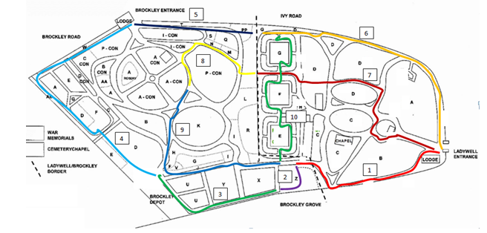
The transect

Slide 3
Methodology
Carried out weekly on the UKBMS methodology
The walk is divided into 10 sections
Numbers of each species noted in each section
It only counts Butterflies within 10m by 10m box directly in front of the surveyor
Only done when temp is over 14 in clear sky or 17 in cloudy conditions

Slide 4
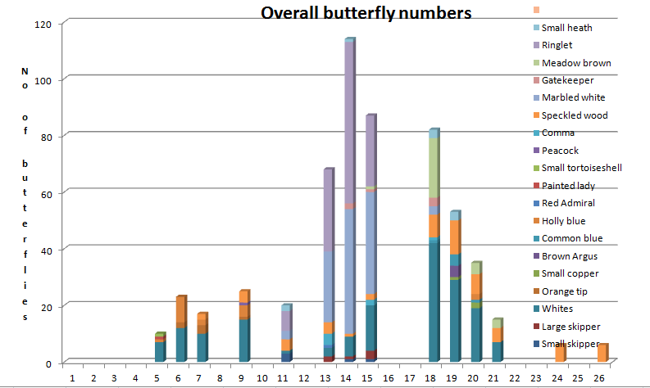
Overall Results

Slide 5
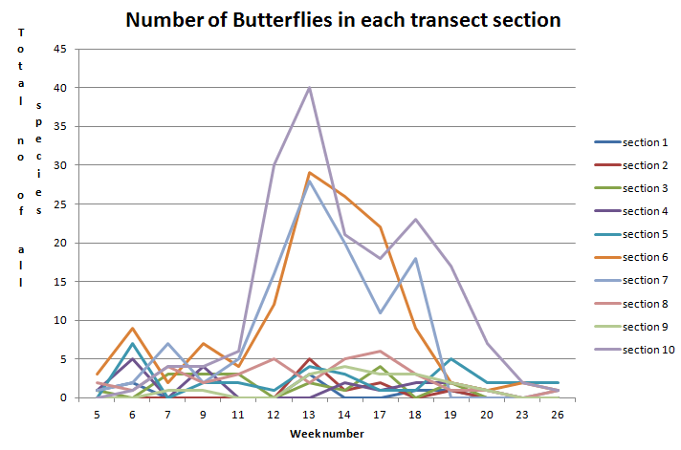
Numbers in each transect section

Slide 6
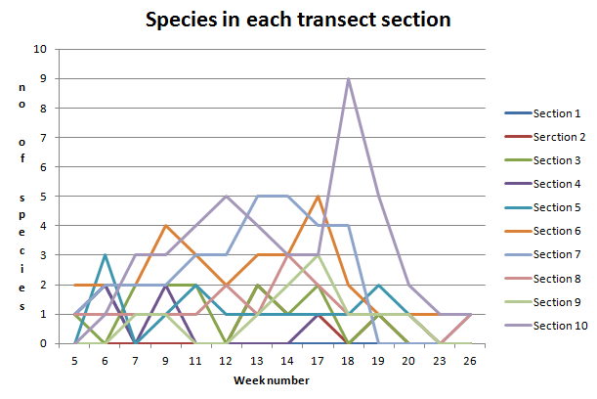
Number of species in each transect section

Slide 7
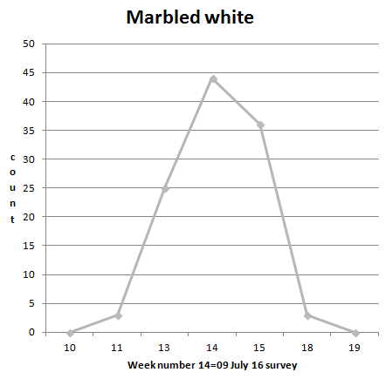
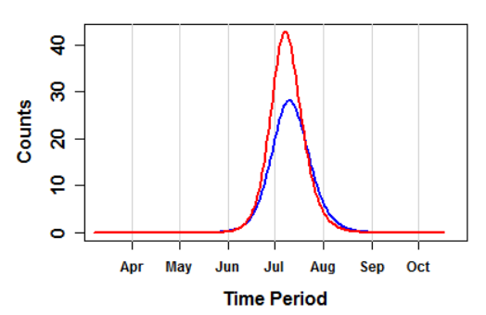
Marbled White

Slide 8
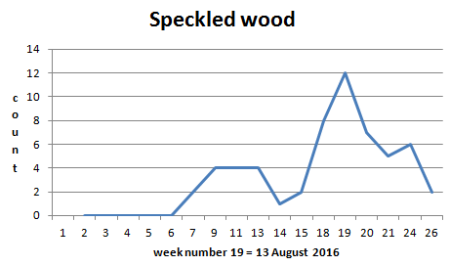
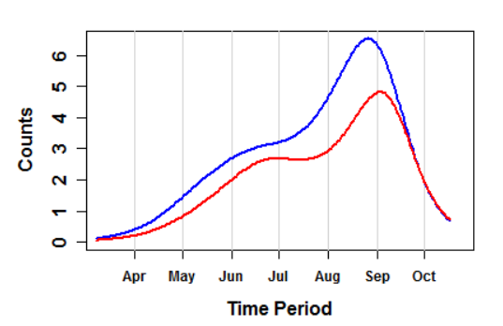
Speckled Wood

